Slide 1
MSRP – HR Recruitment Module
Local Assignments and Fast Track Unit

Slide 2
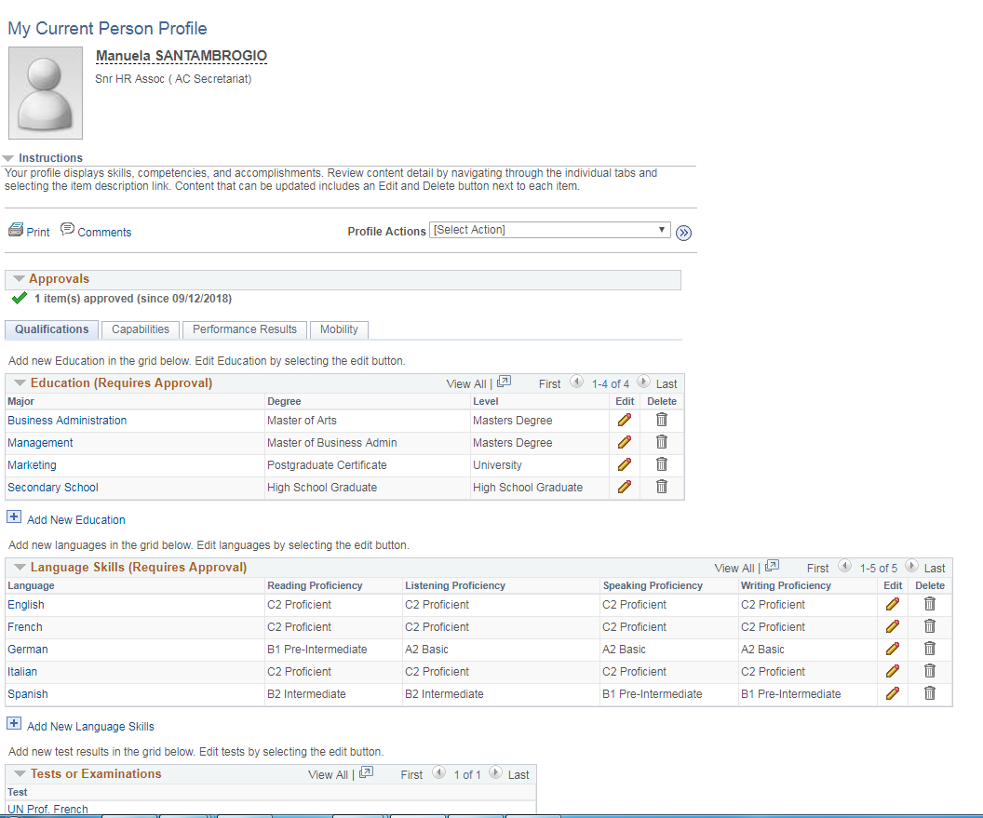
Requirements in order to be able to apply to JO in the system
Make sure the info concerning your profile are updated: you can check through
Self Service/Learning and Development/ My Current Profile

Slide 3
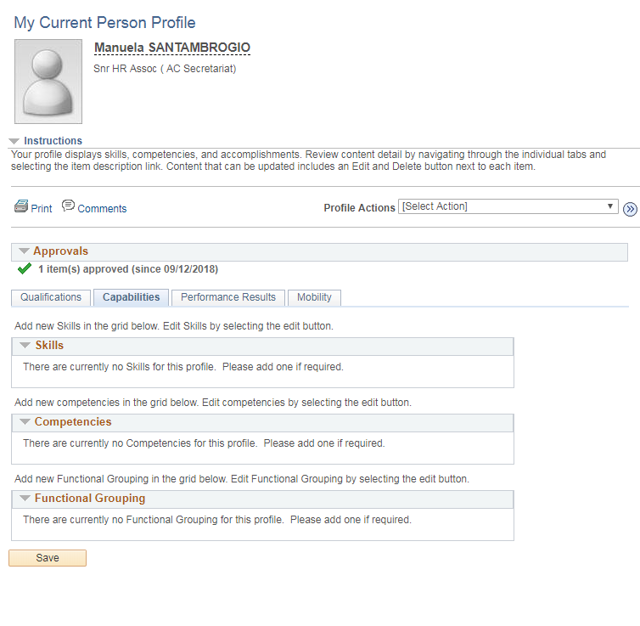
Requirements in order to be able to apply to JO in the system
Capabilities
Performance Results
Mobility
Can’t be changed

Slide 4
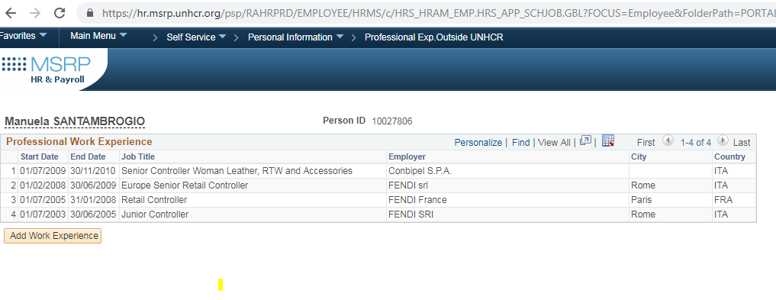
Requirements in order to be able to apply to JO in the system
You need to have at least one Professional Experience Outside UNHCR in order to apply
Self Service/Personal Information/Professional Exp.Outside UNHCR
If you do not have any Professional Exp. Outside UNHCR:
Please click on “Add Work Experience” and include “UNHCR is my first employer”, otherwise you won’t be able to apply

Slide 5
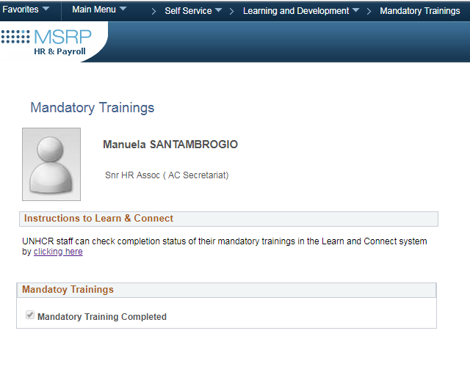
Requirements in order to be able to apply to JO in the system
Mandatory trainings must be completed.
Self Service/Learning and Development/ Mandatory Trainings
Please find the list below:
BSAFE (NEW)
UN Programme On The Prevention Of Harassment, sexual Harassment and Abuse Of Authority;
Protection Induction Programme;
Preventing Sexual Exploitation and Abuse (PSEA);
ICT Information Security Awareness Training (InfoSec);
Fundamentals of Fraud and Corruption Awareness.

Slide 6
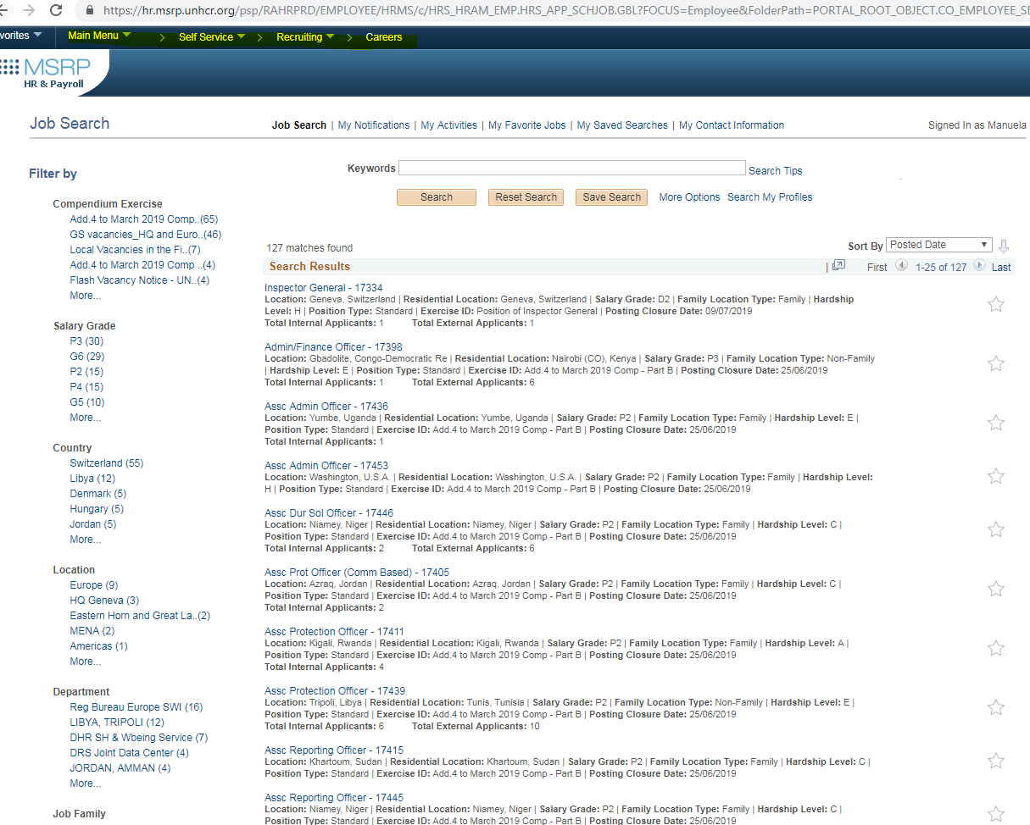
How to apply to JO in the system (MSRP)
Navigation is shown below:
Main Menu / Self Service / Recruiting / Careers
you can filter by:
Location
Grade
JO #
other
Closing date is included:
when the Closing date has passed no further on-line applications will be possible

Slide 7
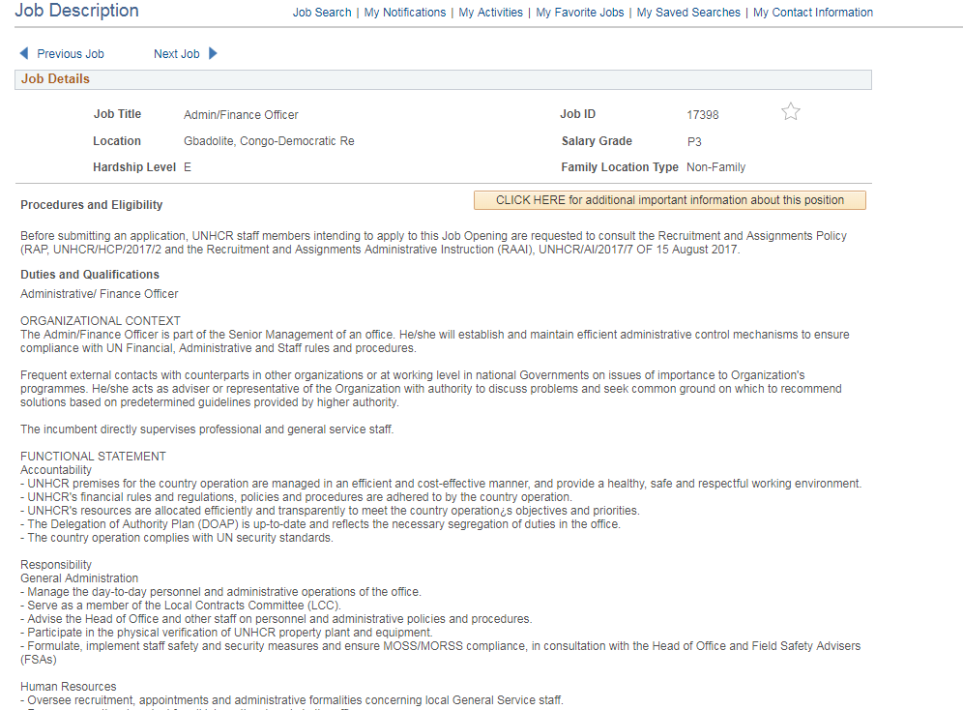
How to apply to JO in the system: JD and OC
Select the JO you want to apply: You will be directed to the JD page: click on the Operational Context link in order to have more info for the specific position

Slide 8
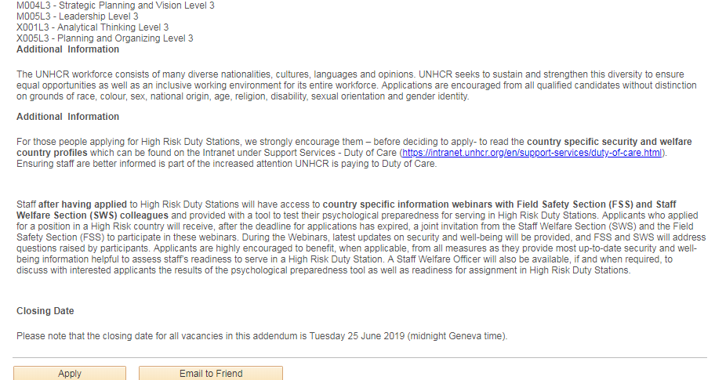
How to apply to JO in the system: JD and OC

Slide 9
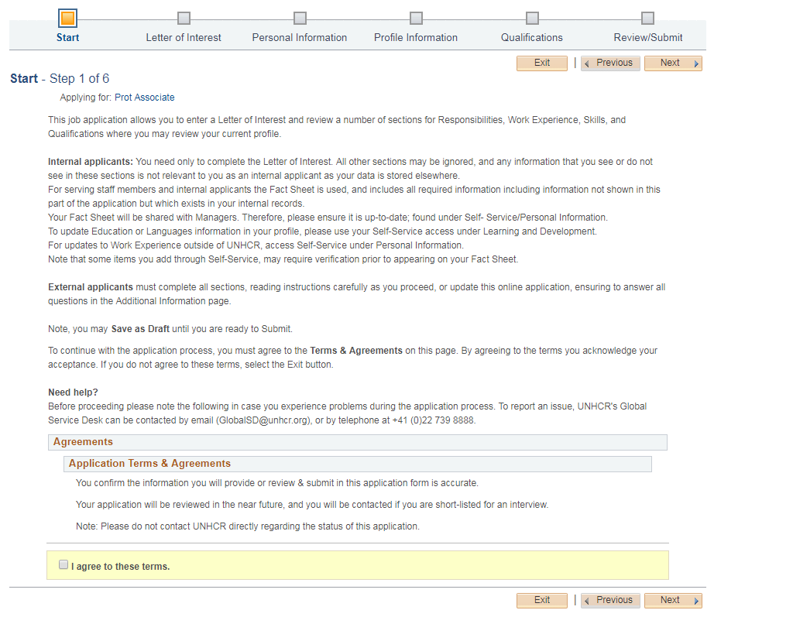
Application
By clicking “Apply”:
You will be directed to the below page
Applicants must agree on the application terms

Slide 10
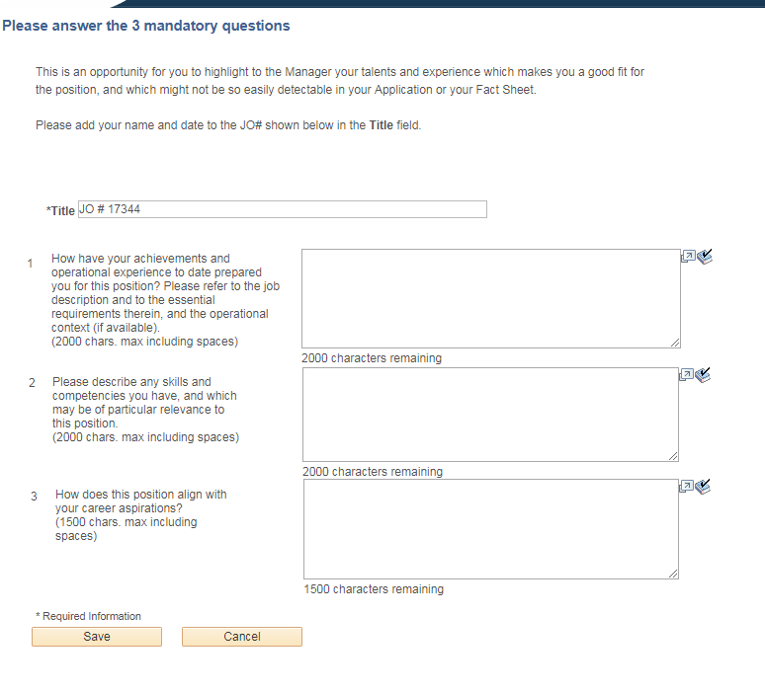
Letter of Interest
3 mandatory questions
Applicants must pay attention to the numbers of characters

Slide 11
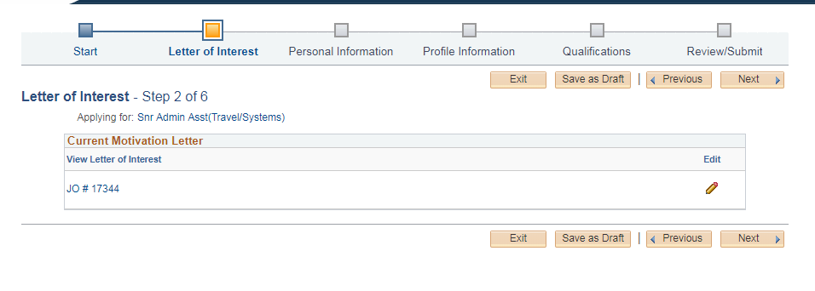
Letter of Interest
Letter of Interest can be edited until the end

Slide 12
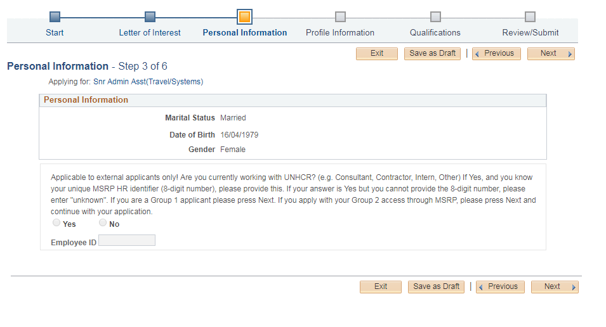
Personal Information
This info can’t be changed

Slide 13
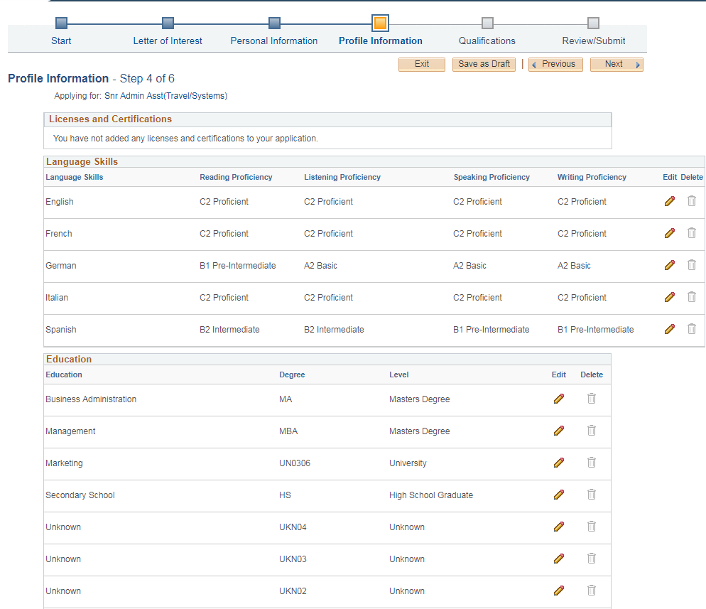
Profile Info
This info can’t be changed from this page:
You need to go through the Self-service prior to completing the application
to make updates:
Self Service/Learning and Development/ My Current Profile
Once the updates are recorded: you need to withdraw and re-start your application

Slide 14
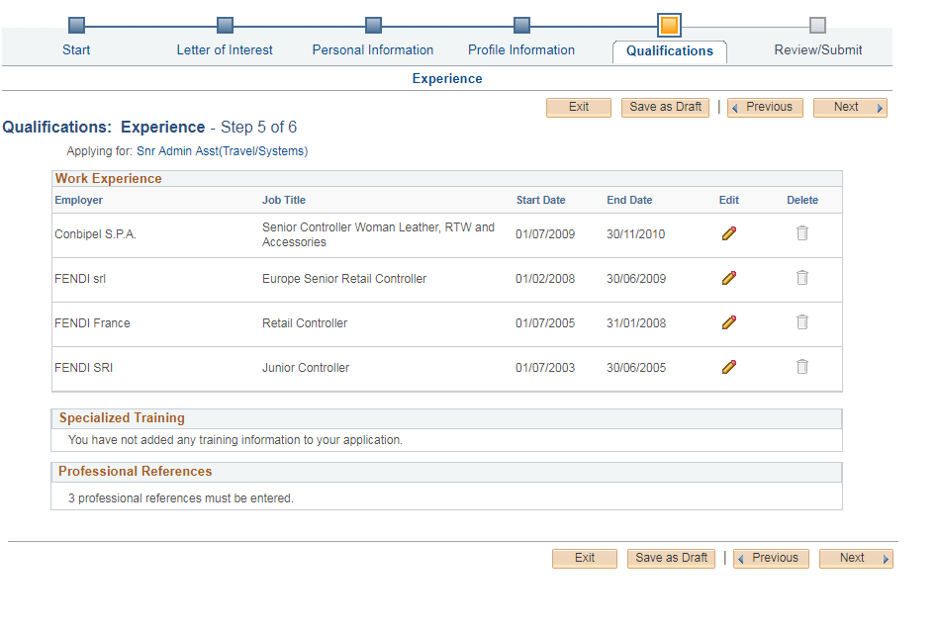
Qualifications
Work Experience: this info can’t be changed from this page:
You need to go through the Self-service prior to completing the application
Specialized Training
Professional References
N/A for Internal applicants
(you can’t change/add anything)

Slide 15
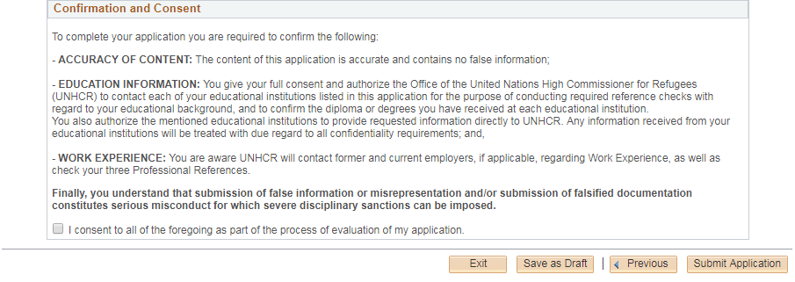
Review/Submit
Click and Submit

Slide 16
Check and Manage your Applications
You can check the status of your applications from:
Recruiting / Careers/ My Activity
You can withdraw by clicking here

